Slide 1
City of Mesa Final Presentation
Group 1.5 Archana Rungta, Wenbo Li, Ka Ho Tan, Joey Rusnak, Ramanathan Venkatakrishnan

Slide 2
Agenda
Introduction/ Recap of the problem
Hypotheses
Data preparation and Consolidation of Data
Model Presentation
Visualizations based on data
Conclusions and Recommendations

Slide 3

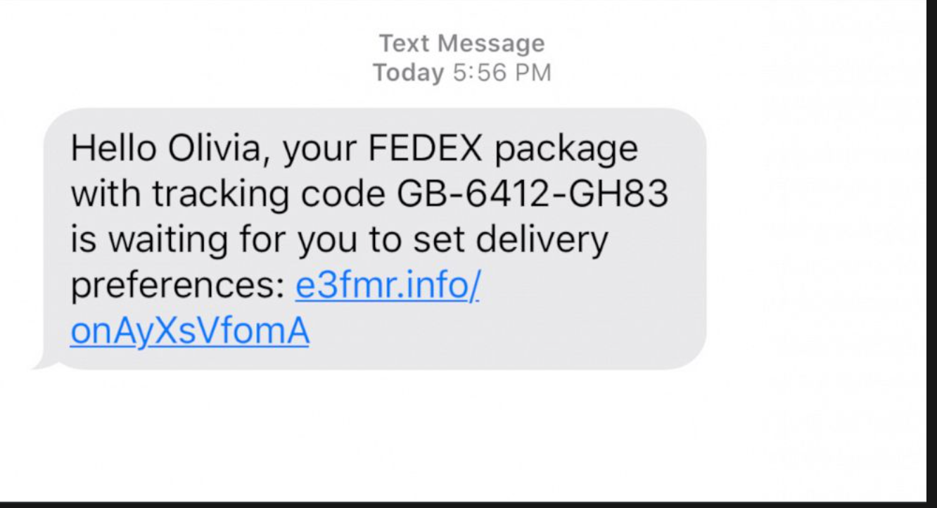
Recap of the problem
The city of mesa’s employees receive hundreds of emails every day, a couple of them were phishing emails sent by the City to track how susceptible their employees are to phishing attempts. If an employee failed the test, they had to take classes on anti-phishing measures, so it won’t happen again.
If an employee get phished we want to analyze how effective the current phishing training modules are and how effective they are in preventing future phishing attempts, real or simulation.

Slide 4
Hypothesis
Employees more likely to not get phished, after taking an anti phishing class.
Likelihood of getting phished reduces after employees undergo phishing modules/classes
Before and after training modules/phishing simulations
Likelihood of employees accounts being compromised based on:
Click rates
Teachable Moment Started
Phishing Templates
Decision tree /random forests
K means clustering analysis
Naive Bayes
SVM
Logistic regression

Slide 5

Data Preparation
Removed null values
Deleted values that were not meaningful
Deleted column with data that did not meet certain criteria
Date (not adding value)
Renamed and rearranged columns
It was important to modify data into being binary so that we could properly run our models

Slide 6
Consolidating Data
After we sorted the data, our team went through multiple excel workbooks to extract the rows and columns from each of the datasets that would be useful for our models and visualizations
We then had to take that data and combine it to one excel sheet so that it would be useful for analysis and running our models.

Slide 7
Model Presentation
We ran various models including, a decision tree, random forests, K means Naive bayes and SVM using Orange and Python to find out what factors go into employees getting phished and what we can do to predict how likely an employee will get phished.
We evaluated the models we ran on phishing campaigns between each other and analyzed our models effectiveness against each of these campaigns. In the next slides we will show what we have found

Slide 8
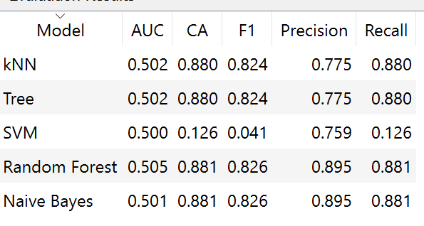
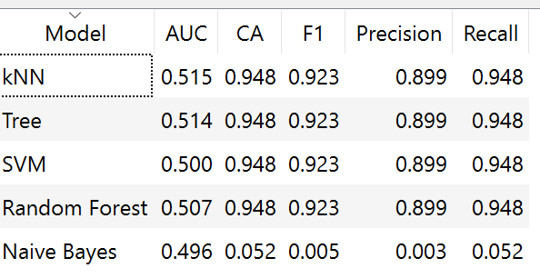
Analysis of Models Non PD campaigns Vs PD Campaigns
Non Police Department Campaigns
Police Department Campaigns
TARGET: REPORTED
Notes:
On this slide we have a comparison between the models ran on a dataset containing all of the employees not working in Police departments, and analyzed them to the campaigns that were run at the Police departments. Although we have a relatively low AUC value of around 50% for both of our models. This is not a bad start as it shows our model has a ways to go and improve. Once we get more insight from the City of Mesa we can improve our dataset and our models accuracy will rise accordingly. Our only issue was not being able to run logistic regression on the current version of our data because our data had too many non numeric variables to analyze and we were unable to get meaningful results from the logistic regression we did run.

Slide 9
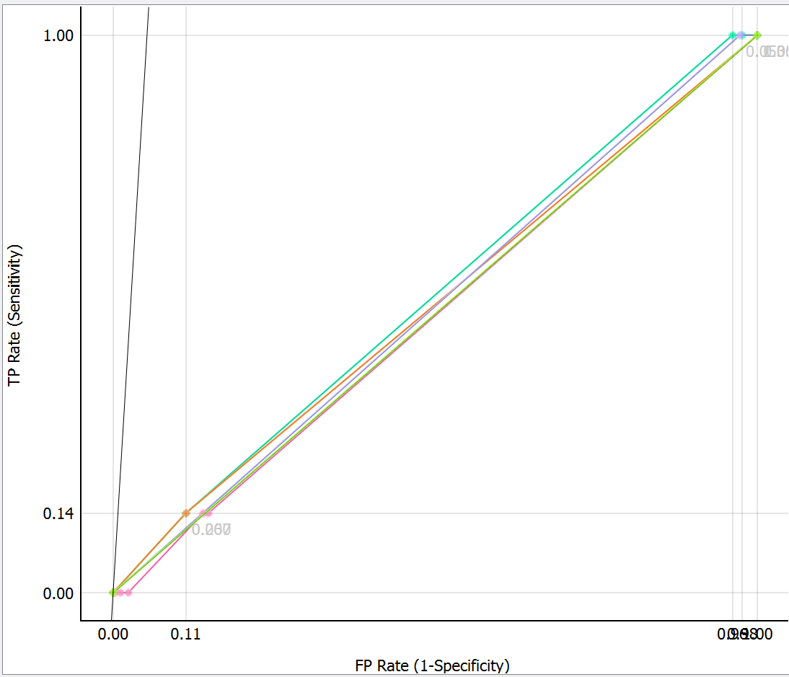
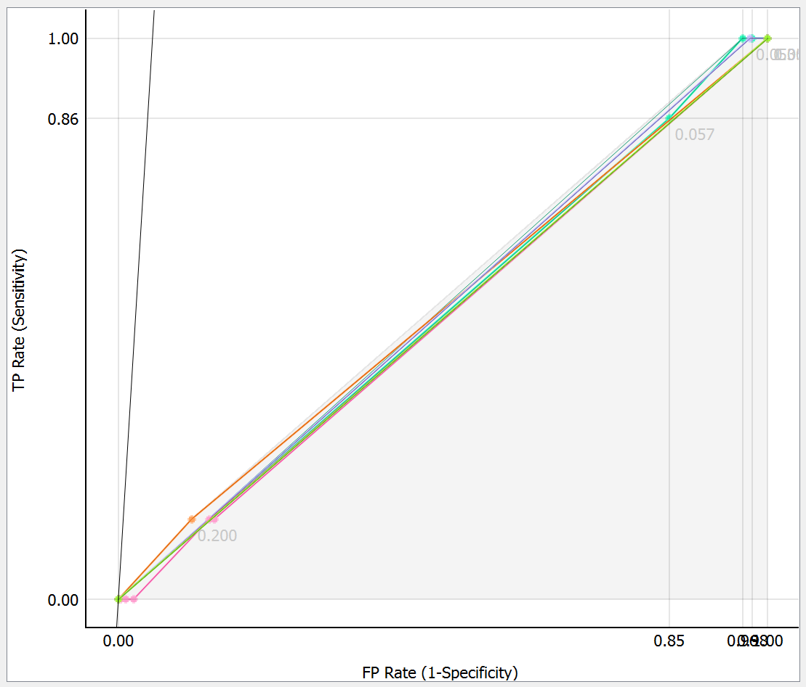
Analysis of Models Non PD campaigns Vs PD Campaigns
Non Police Department ROC GRAPH
Police Department ROC GRAPH

Slide 10
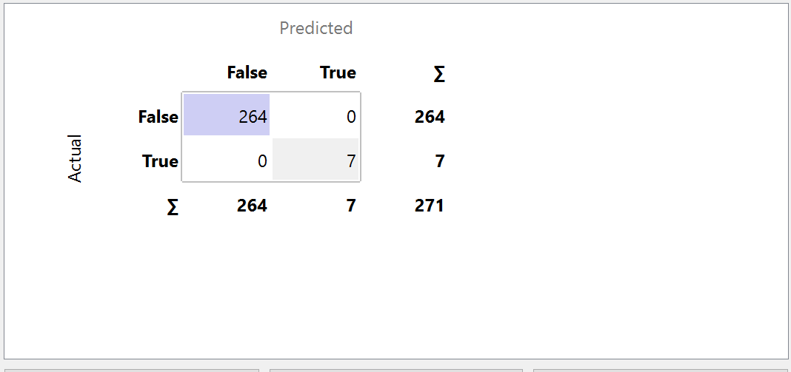
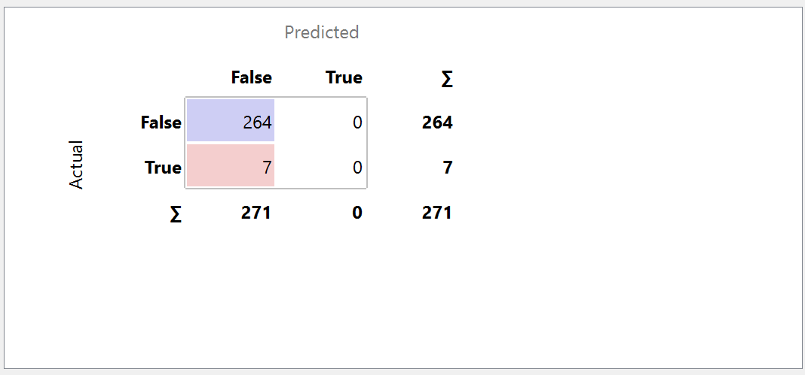
Confusion Matrices
K-Nearest Neighbours Analyzing Reported Decision Tree Analyzing Reported

Slide 11
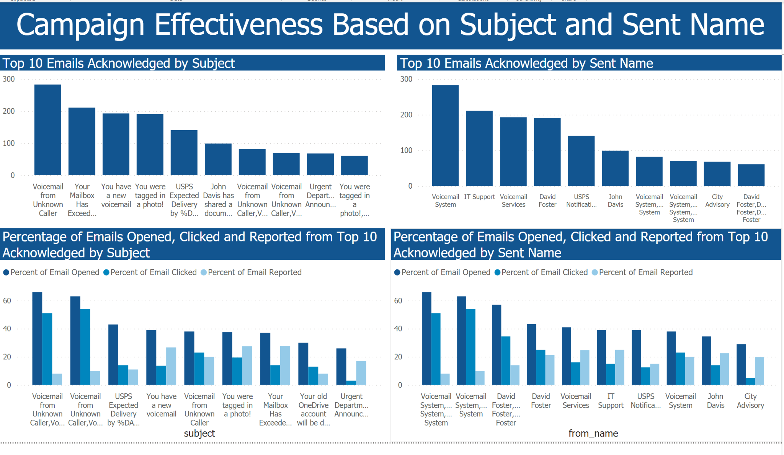
Interpretation of Analysis

Slide 12
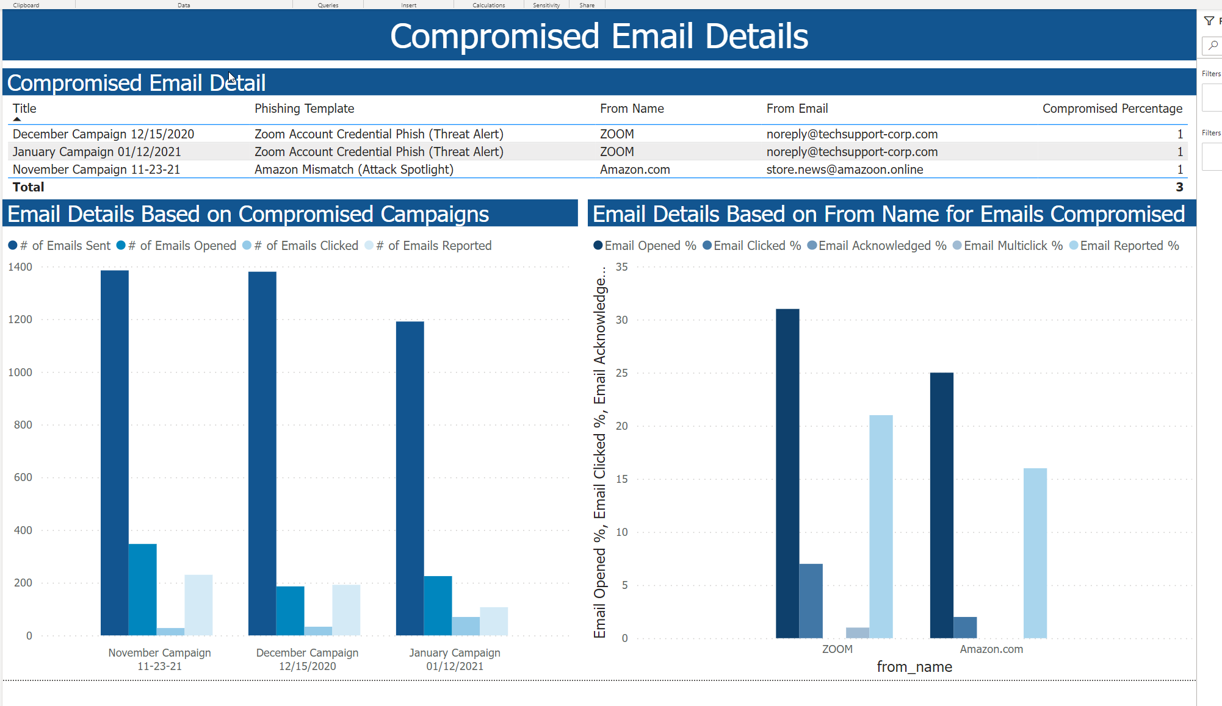
Preliminary Analysis Findings

Slide 13
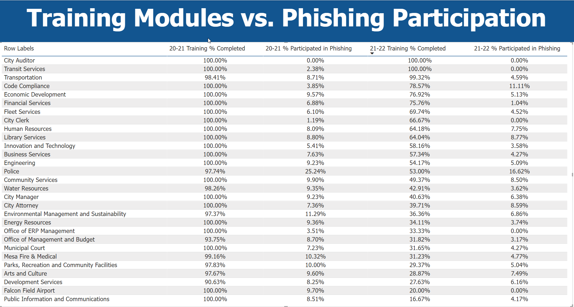
Preliminary Analysis Findings

Slide 14
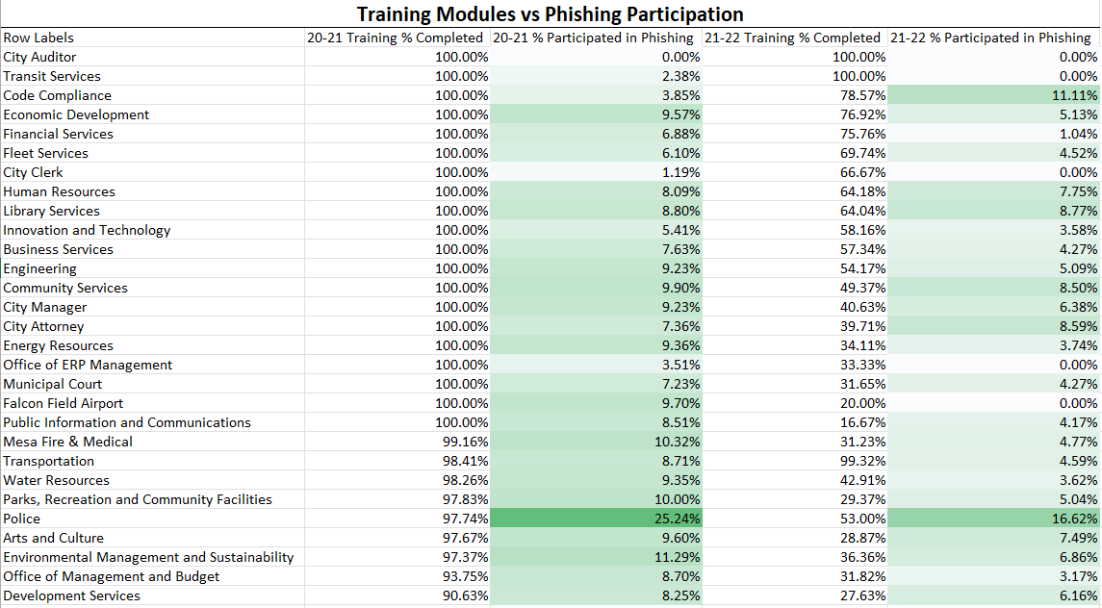
Heat Map

Slide 15
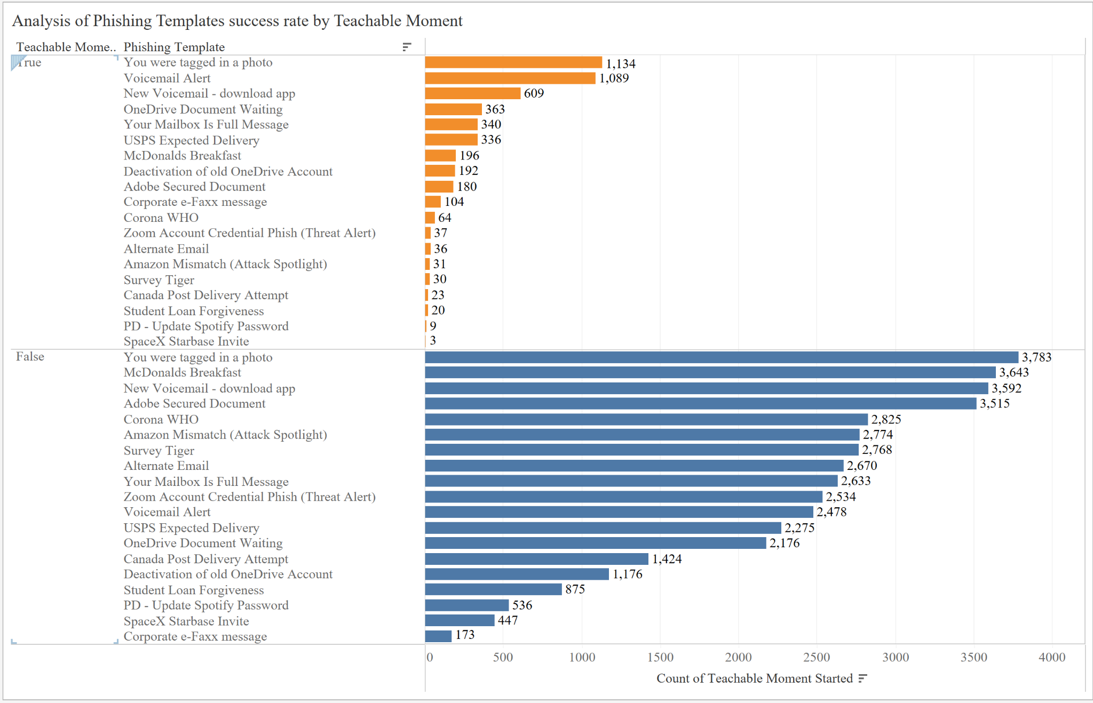
Comparison of Phishing Template Success Rate

Slide 16

Evaluation Disclaimer
Disclaimer - Our intention is to evaluate actions, needs, preferences, and the beliefs of the employees so that we can provide insights on the anti-phishing training modules
Personal information
Used the data without identifying personal information
Respected the dignity of the data
Kept the data as transparent as possible

Slide 17
Conclusions and Recommendations
Conclusions:
- Police Department highest number of individuals who were successfully phished in 2020-2021
- 10% decrease in 2021-2022
- Most Successful phishing campaign - “You’ve been tagged in a photo” & “New Voicemail” Phishing campaigns.
- Overall decrease in successful phishing in 2022 compared to 2021
Recommendations: - Increase sophistication of current phishing simulations / add more social media phishing campaigns
- Test - employees are tasked with clicking on the “right links” or suspicious links
Notes:
We have also found that some departments are less likely to complete the phishing assessments but we are still not sure how effective the campaigns are at preventing future phishing attempts, and how effective the training assignments are
We will use the data we have found from our preliminary analysis to build on the models we will create for the next presentation

Slide 18
THANK YOU

